Slide 1

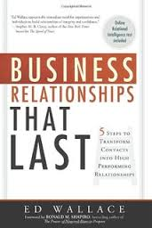
Target Conversations With Your Ideal Buyers
:

Slide 2
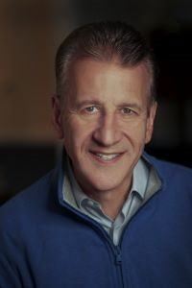
Ed Wallace
Managing Director, AchieveNEXT Human Capital
Ed consults with and speaks for corporations and associations across the globe with a client list that is a Who’s Who of Fortune 500 companies. He is the author of Fares to Friends, Creating Relational Capital, Business Relationships That Last, and his most recent the #1 best seller, The Relationship Engine. Ed was recently published in the Harvard Business Review. In addition, he is currently on the Executive Education faculty of Drexel’s LeBow College of Business and Villanova University’s Human Resources Master’s program. https://www.linkedin.com/in/edwallace007/

Slide 3
How many minutes of actual value do decision makers perceive during a 60 minute sales call?
Notes:
Group chat question

Slide 4
6
Source: HubSpot

Slide 5
Relational Capital
“The distinctive value created by people in a business relationship”

Slide 6
Question
What is the definition of Credibility?
Do what you say you are going to do
Keep your promises
The power to elicit belief
None of the above

Slide 7
Credibility
The Power to Elicit Belief

Slide 8
Essential Qualities of Relational Capital
Credibility
Relational Capital
Integrity
Authenticity

Slide 9
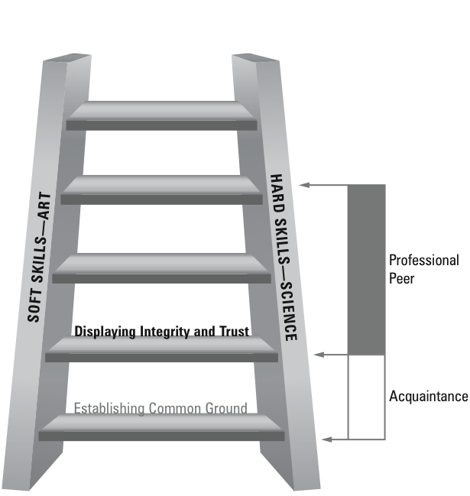
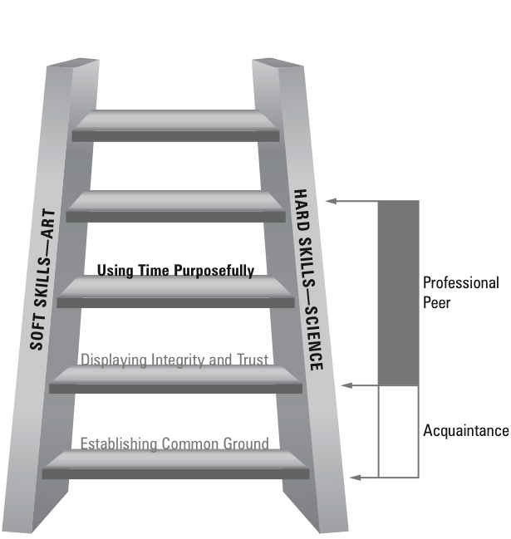
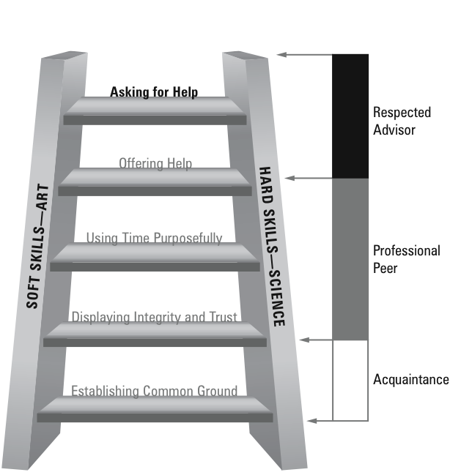
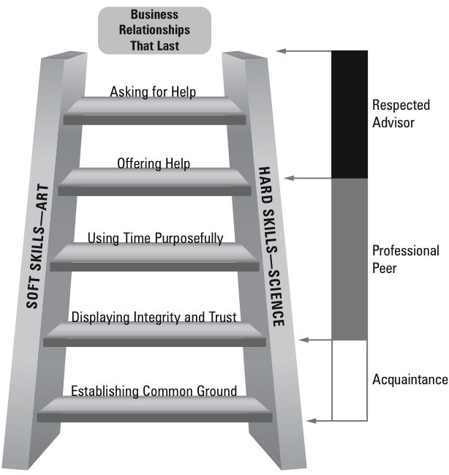
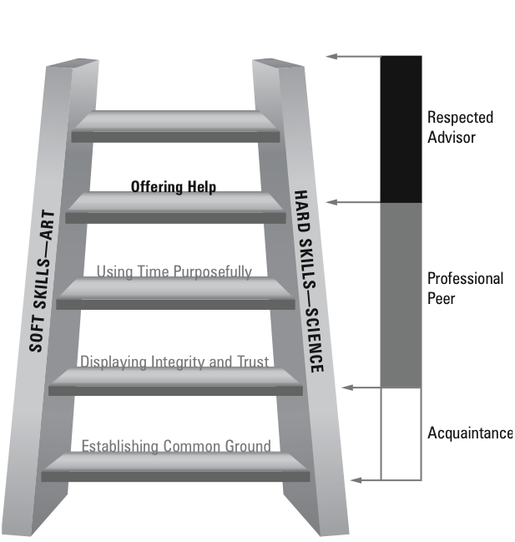
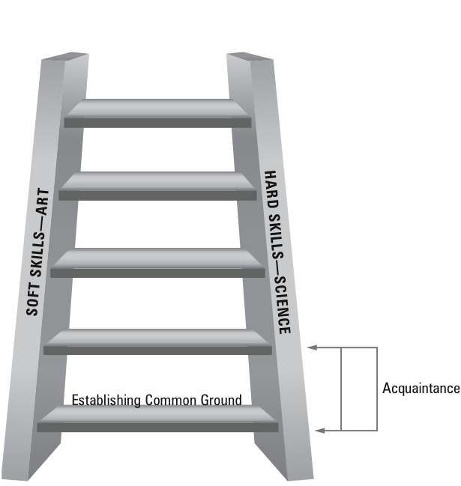

Relational Ladder®

Slide 10
Relational Ladder®

Slide 11
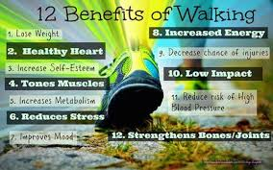
Dr. Fred

Slide 12
What % of decision makers expect salespeople to understand how their offerings contribute to their business outcomes?
Notes:
Group chat question

Slide 13
85%
Source: HubSpot

Slide 14
How many salespeople connect their solution to the outcomes of the decision maker’s business?
Notes:
Group chat question

Slide 15
< 14%
Source: HubSpot

Slide 16
Targeted Conversations

Slide 17
Targeted Conversations
Helps you align with the Persona of your contact
  Develop a pre-meeting plan
    Considering their Goals and Struggles
    Creating credibility advancing Discovery questions
    Supported by a Value Proposition

Slide 18
Decision Maker
Persona: Plant Manager
Identify the typical Goals and Struggles for this Persona
Goals:
Reduce downtime
________________________________________
Struggles:
Finding resources
________________________________________
Notes:
Goals:
1. Meet all clinical metrics to provide superior care for patients and meet CMS requirements for patient care
2. Meet all operational goals (specifically budget)
**Around these two, having the right team in place is crucial, because without them, the goals cannot be met!
Struggles
1. TM Retention
2. Balancing competing priorities of all DaVita metrics (top goals for DaVita in 2015-2016 – be the clinical leader (lots of different metrics combined here, which their TMs like RNs, SWs and RDs are responsible for handling), create a special place (focus on TM retention, training and experience), Ops Excellence (meet budget with labor hours, treatment goals) and lastly Growth (accepting all new patient admissions to ensure we provide our high quality clinical care to everyone possible)

Slide 19
Discovery
Notes:
Lynn to use this to close this principle

Slide 20
Discovery
Understand the customer’s business through strong Discovery questions
Discovery – focused on business outcomes aligned with the decision maker

Slide 21
Strong Discovery Questions
What do you find as your team’s biggest accomplishment in the last 4-6 months?
I see from LinkedIn you have been in this role since___ what made you want to get in this industry?
How has your role changed since Covid?
I see we are both connected to ______ on LinkedIn? How do you know them?
OTB Solutions LLC

Slide 22
Discovery Questions
What probing questions could you develop to learn more about their Goals and Struggles?
1.____________________________________________
2.____________________________________________
3.____________________________________________

Slide 23
ASK, ASK, ASK
Why is that?
Can you tell me more?
Is there anything else?

Slide 24
ASK, ASK, ASK, TELL

Slide 25
What is a Value Proposition?
OTB Solutions LLC
Notes:
Lynn to use this to close this principle

Slide 26
Value Proposition Descriptions
  Why your firm is the first, largest, etc.
  Why your solution leads the market.
  How much experience you have.
  Why your firm is an innovator
  How the customer will use/benefit from your solution
© 2008-2014 Relational Capital Group.
26
Notes:
IMPORTANT PAGE

Slide 27
Value Statement Shorthand
Clear statement
Through the eyes of the customer
Delivers benefit
  Increases
  Decreases
  Eliminates

Slide 28
Sources of Value
 | Source of Value (SO WHAT?) | Language of the Customer
1 | Responsiveness | Their call gets answered
2 | Made in the USA | Avoid shipping delays
3
4
5
6
7
8
9
10
© 2008-2014 Relational Capital Group.
28
Restricted-Dow Internal Use Only
Notes:
Look back at slide 39 for pivotal conversations and dimensions
Debrief each group and let people add to the list

Slide 29
“GO TO” Value Statement Template
When a customer asks, “So what can you do for us?”
We help you increase {_____________} or decrease {____________} or eliminate {_____________}
through (add a solution phrase) {__________________________}
Avoid explaining too much because you want the customer to ask, ‘How are you going to do that?'

Slide 30
Application Exercise
Notes:
Lynn to use this to close this principle

Slide 31
Decision Maker
Persona:
Identify the typical Goals and Struggles for this Persona
Goals:
________________________________________
________________________________________
Struggles:
________________________________________
________________________________________
Notes:
Goals:
1. Meet all clinical metrics to provide superior care for patients and meet CMS requirements for patient care
2. Meet all operational goals (specifically budget)
**Around these two, having the right team in place is crucial, because without them, the goals cannot be met!
Struggles
1. TM Retention
2. Balancing competing priorities of all DaVita metrics (top goals for DaVita in 2015-2016 – be the clinical leader (lots of different metrics combined here, which their TMs like RNs, SWs and RDs are responsible for handling), create a special place (focus on TM retention, training and experience), Ops Excellence (meet budget with labor hours, treatment goals) and lastly Growth (accepting all new patient admissions to ensure we provide our high quality clinical care to everyone possible)

Slide 32
Discovery Questions
What probing questions could you develop to learn more about their Goals and Struggles?
1.____________________________________________
2.____________________________________________
3.____________________________________________

Slide 33
Sources of Value
 | Source of Value (SO WHAT?) | Language of the Customer
1
2
3
4
5
6
7
8
9
10
© 2008-2014 Relational Capital Group.
33
Restricted-Dow Internal Use Only

Slide 34
“GO TO” Value Statement Template
When a customer asks, “So what can you do for us?”
We help you increase {_____________} or decrease {____________} or eliminate {_____________}
through (add a solution phrase) {__________________________}
Avoid explaining too much because you want the customer to ask, ‘How are you going to do that?'

Slide 35
Qualifying
Notes:
Lynn to use this to close this principle

Slide 36
Qualifying Questions
BANT
Do they have a Budget?
Does buyer have Authority?
Do we understand Need?
Do we understand Timeline?
OTB Solutions LLC

Slide 37
Qualifying Questions
BANT
Do they have a Budget?
Do you have a targeted budget?
How much have you spent for similar purchases in the past?
Have you been given a budget or will we need to create a business case for one?
OTB Solutions LLC

Slide 38
Qualifying Questions
BANT
Does buyer have Authority?
Are you the decision maker?
Is there someone else you would like to include in the discussion?
OTB Solutions LLC

Slide 39
Qualifying Questions
BANT
Do we understand their Need?
You mentioned ____ is a current challenge…how long has this been an issue?
What have you tried so far to improve?
Other sales leaders have shared ____is also an issue today, are there other issues that impact this challenge?

Slide 40
Qualifying Questions
BANT
Do we understand Timeline?
What made this something you want to solve now?
What is your timeline to solve this?
What’s the cost of not solving this ?
OTB Solutions LLC

Slide 41
Your Qualifying Questions – B.A.N.T.
1. Budget ___________________________________________________
____________________________________________________________
2. Authority __________________________________________________
____________________________________________________________
3. Need _____________________________________________________
____________________________________________________________
4. Timeline __________________________________________________
____________________________________________________________

Slide 42

Relational Leaders…
…think “relationship first” during every interaction!!!

Slide 43

Next Steps
1. Ed’s eBook Business Relationships That Last
2. Complementary RQ Assessment – measure the strength of your top five relationships
3. Special ABMA Member Value on Accelerating Business Relationships sales training experience
Text Grant Wallace at (610) 306-3648 or email him at grant.wallace@achievenext.com to learn more about these offers.

Slide 44
Accelerating Business Relationships
This material is owned by, and the property of The Relational Capital Group®. This material is intellectual property and is confidential. Any reproduction, copying, or other use of this material in any manner without the express written permission of the owner is strictly prohibited.
The Relationship Engine, Relational Ladder, The Five Principles of Worthy Intent, Relational GPS, ROC, Relational Capital Gains, RQ, RQ Pro, and Relational Capital Action Planner are registered trademarks of The Relational Capital Group.

